Slide 1
Reminder: A Task manager App
Frank Orefice

Slide 2

What is Reminder?
ReMinder is a task manager application that allows the users to keep track of tasks they want to complete
Users are able to name their tasks and set a due date for its completion
The user also has the ability to choose to be reminded about the task either through text, email or phone call.
The application uses the Twilio API to send the text and phone call reminders.

Slide 3
Features Implemented
When creating a task you can choose to be reminded of the task through text, email and/or a phone call
You can include multiple phone numbers and emails by separating each by a “; “ (semicolon and space). Each phone number should start with the area code (ex: “1”)
On the Home screen you can either click on the tasks to update or delete them or you can click and hold on the task to view it's description

Slide 4
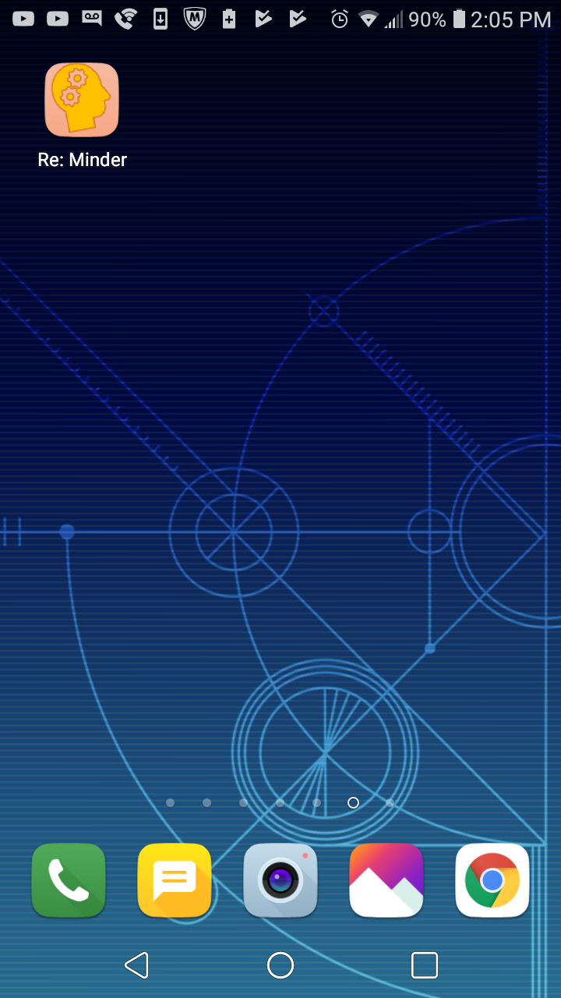
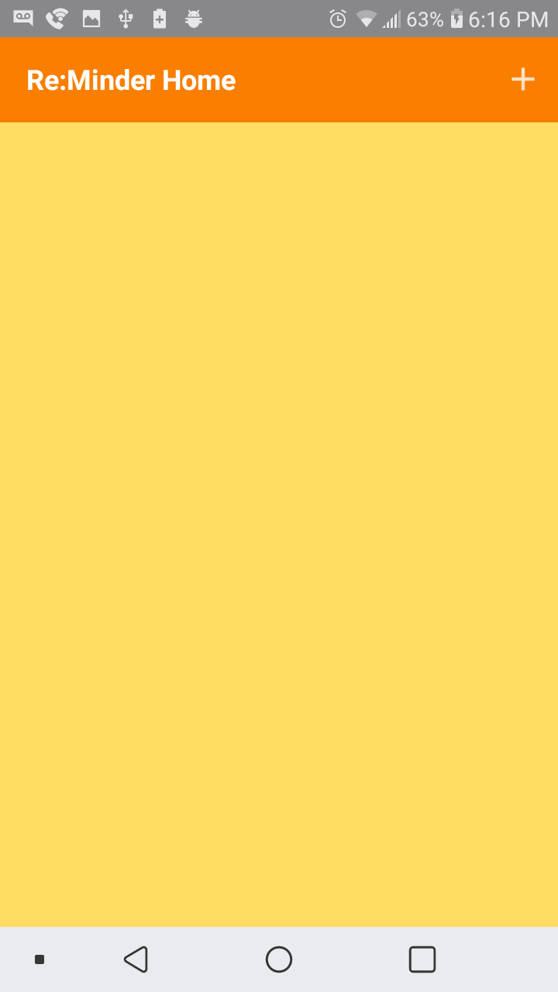
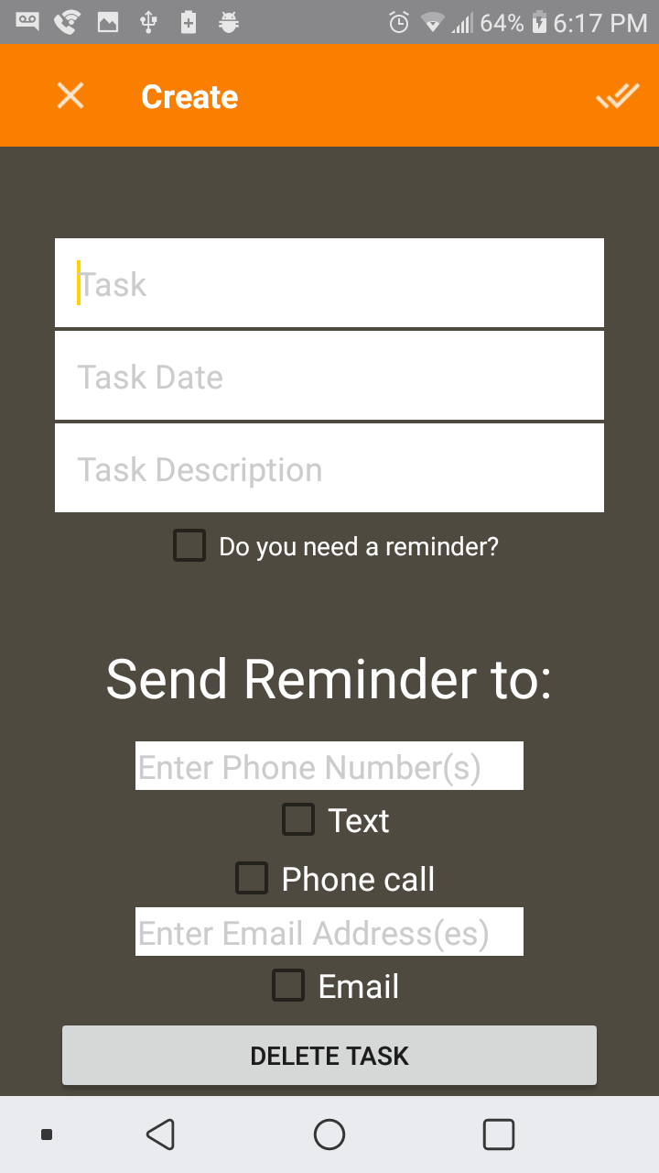
App Screenshots

Slide 5
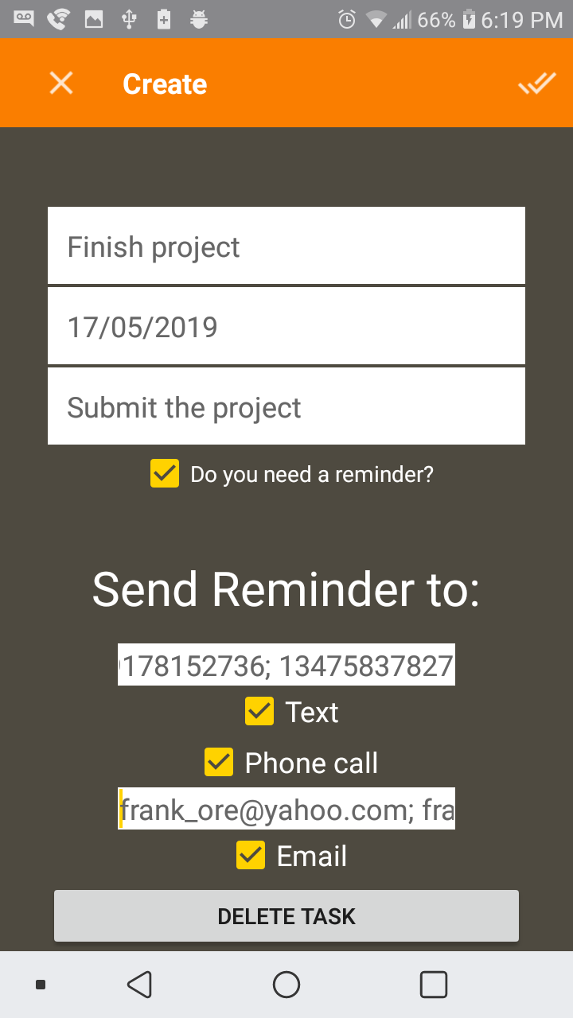
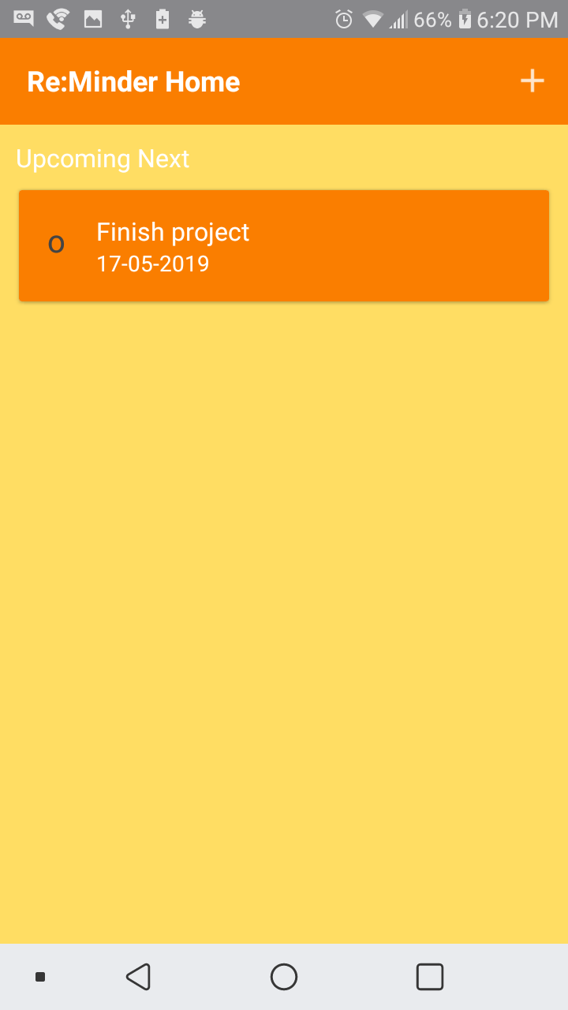
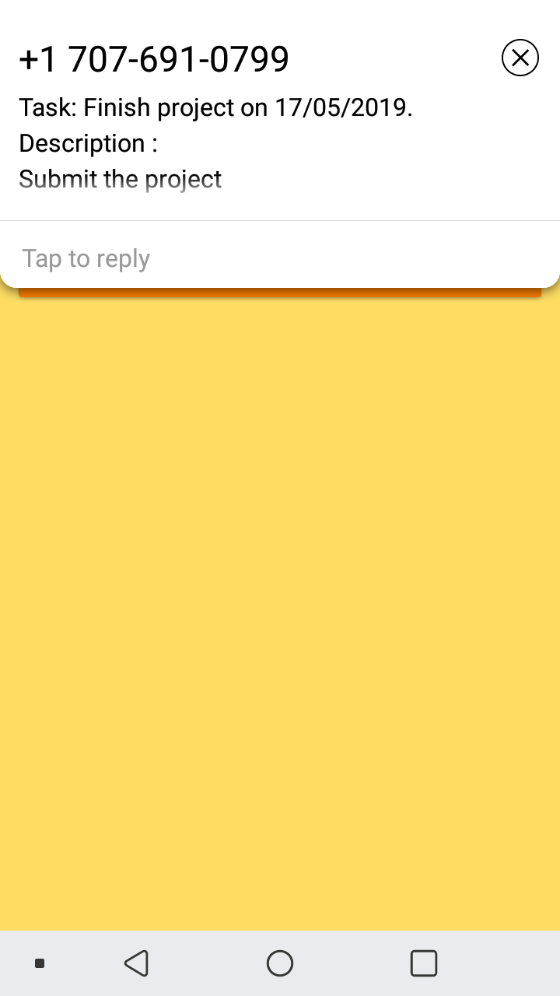
continued

Slide 6
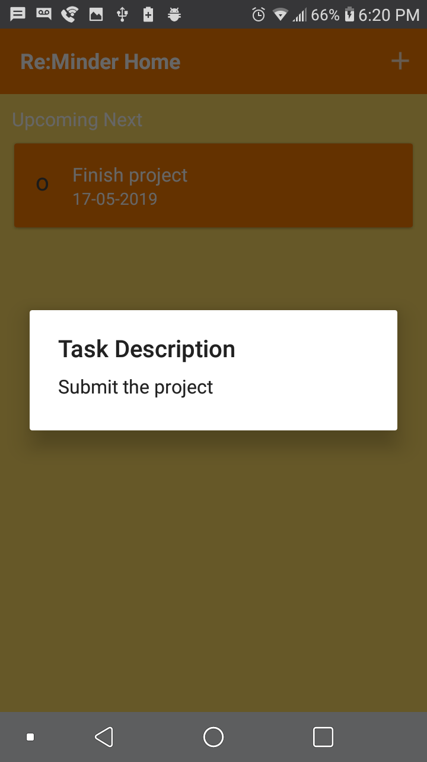
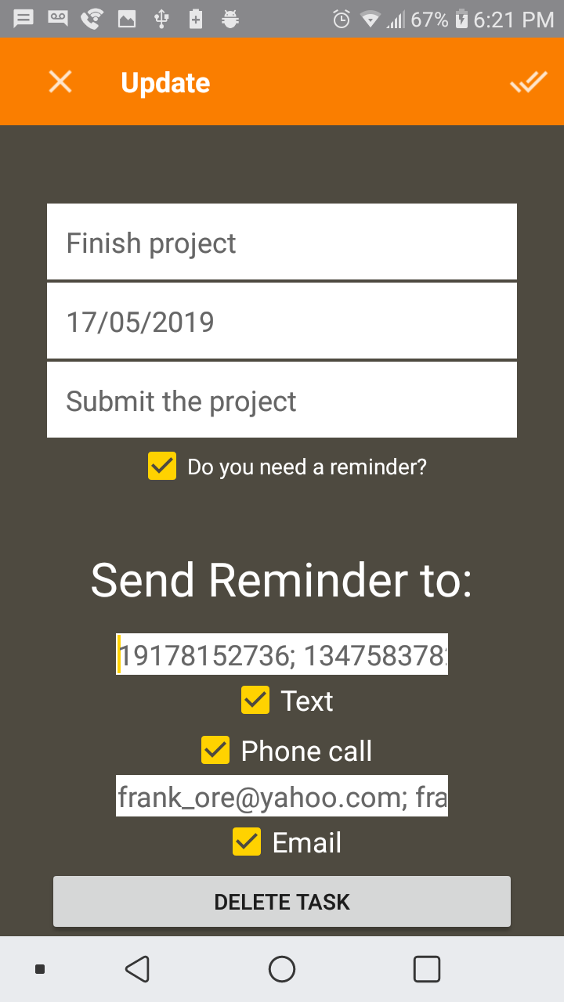
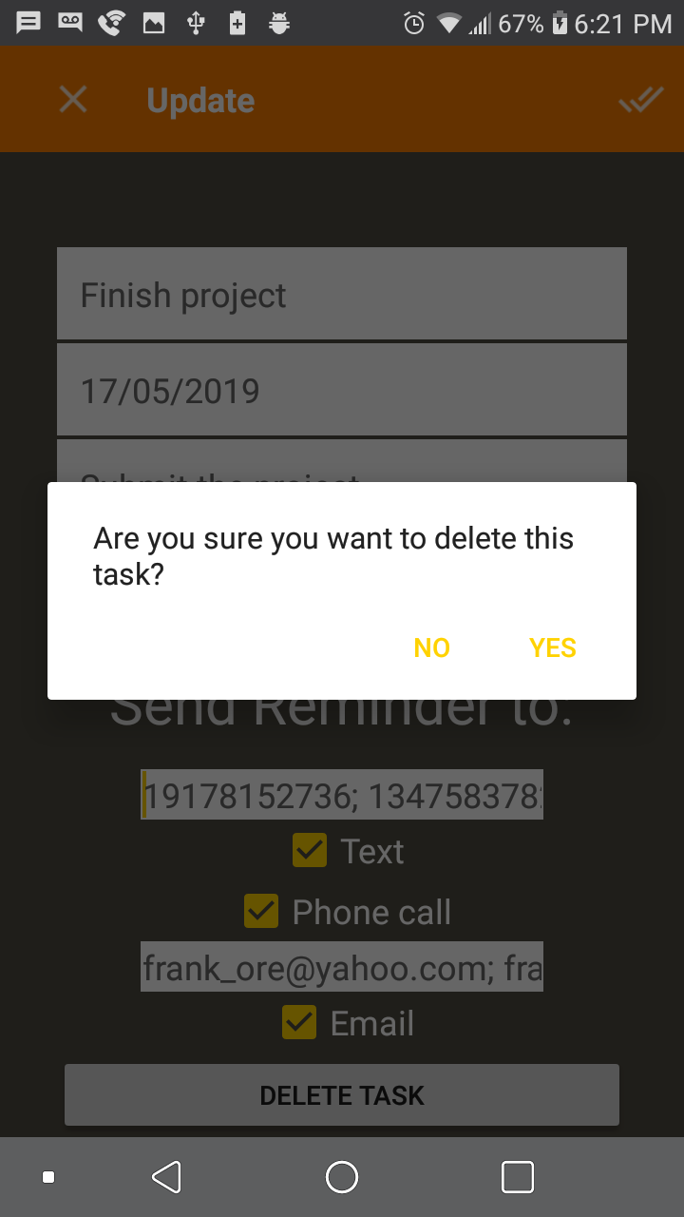

Slide 7
Missing Features
I wasn’t able to implement the feature that would allow the user to receive reminders through Slack. The issue was that for the user to connect their Slack channel to the app, they would need access to the Twilio API and do it manually.
I also wanted to implement a navigation bar so that the user could choose between creating single user tasks and group tasks. However, due to issues with creating the navigation bar and the lack of time, I decided to streamline the app since there aren’t enough features necessitate a navigation bar.

Slide 8
Data Structures used and Saving Tasks
Tasks are saved using an SQLite database
The data structures that I used to store the tasks and their elements were ArrayLists and HashMaps which would retrieve the data from the SQLite database and display it on the screen
When a task is deleted, it is delete from the SQLite database, then the ArrayLists that contain the tasks will be cleared and repopulated using the updated data from the database

Slide 9
Challenges and how I overcame them
I had to learn how to save the tasks on the application when you close the app. I overcame this by learning how to use the SQLite database on Android
I had to find a way to run the script that uses the Twilio API to send the reminders to the user. I overcame this by using Heroku to host the application.
I had to learn how to send text messages and emails through an Android application. I overcame this by looking up tutorials on how to do so.
I had to deal with crashes and debugging the application, so I learned how to use Logcat to check for errors in the app

Slide 10
What I learned
How to use and create an SQLite Database to store information in the Android application
How to gain permission to send text messages through an Android application
Learned how to use Heroku to host the application that sends the reminders to the user
I learned how to debug an Android application using Logcat

Slide 11
What I would like to add
Given more time, I would like to add:
The ability to send reminders through the Slack messaging app
The ability to set reminders that repeat at a specific time (i.e. daily, weekly, etc.)
Having the option of choosing Google Calendar as a medium to receive reminders
A navigation bar so that the user can view certain features of the application separately (i.e. Home Screen, Settings, etc.)

